Slide 1

HR Analytics Dashboard
Tool Used: Tableau
Presented by: Aksa Bashir
Domain: Human Resource Analytics
Objective: To analyze key HR metrics for data-driven decisions.

Slide 2
Data Highlights
Total Employees: 462
Attrition Rate: 33.44%
Active Employees: 311
Average Age: 44
Key Metrics:
- Employee Satisfaction
- Marital Status & Attrition
- Department-Wise Attrition

Slide 3

Attrition Analysis
Insights:
- Higher attrition among males.
- Most affected age groups: 25–44.
- Zero attrition in age group 60+.
Action: Focus engagement on younger employees.

Slide 4
Department-wise Breakdown
High Attrition: Executive, Production, Sales
Better Retention: Admin, IT/IS, Software
Action: Analyze departmental issues affecting turnover.

Slide 5
Job Satisfaction Insights
Ratings (1 to 5): Mostly around 3–4.
High Satisfaction: Sales, Admin
Low Satisfaction: Software, Executive
Action: Target satisfaction improvement where scores are low.

Slide 6

Demographics & Marital Status
Attrition by Marital Status:
- Married and Single: Highest attrition
- Others: Lower impact
Gender: More attrition among males
Action: Tailored engagement strategies.

Slide 7

Conclusions
Actionable Findings:
- Retain 25–44 age group
- Improve high-attrition departments
- Monitor marital/demographic patterns
Strategic Impact: Enables informed HR decisions.

Slide 8

Future Scope
Enhancements:
- Monthly/quarterly trend tracking
- Predictive attrition modeling
- Integrated systems (recruitment, payroll)
- Personalized departmental dashboards

Slide 9
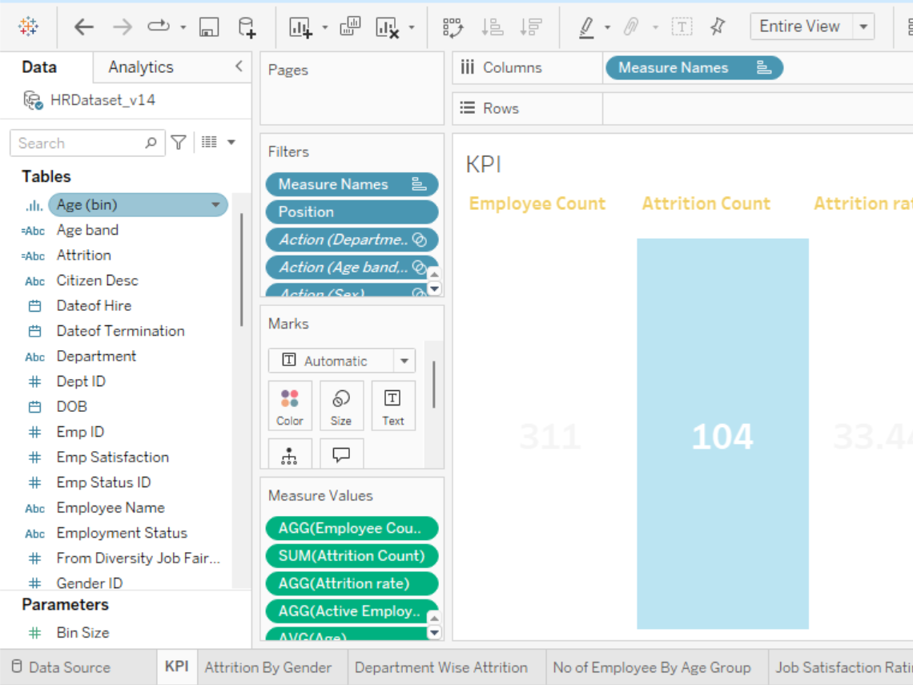
KPI

Slide 10
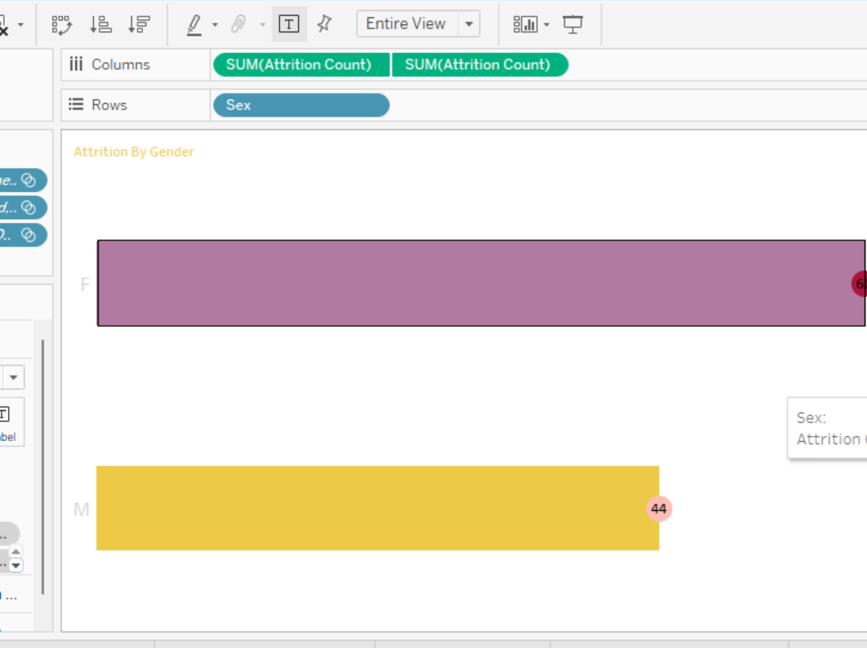
Attrition by Gender

Slide 11
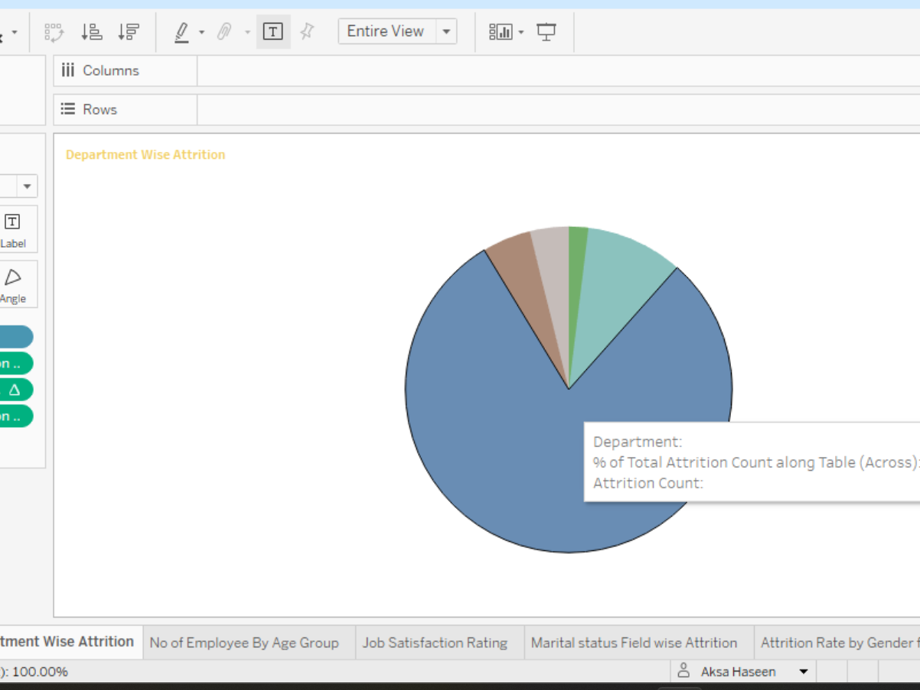
Department-wise Attrition

Slide 12
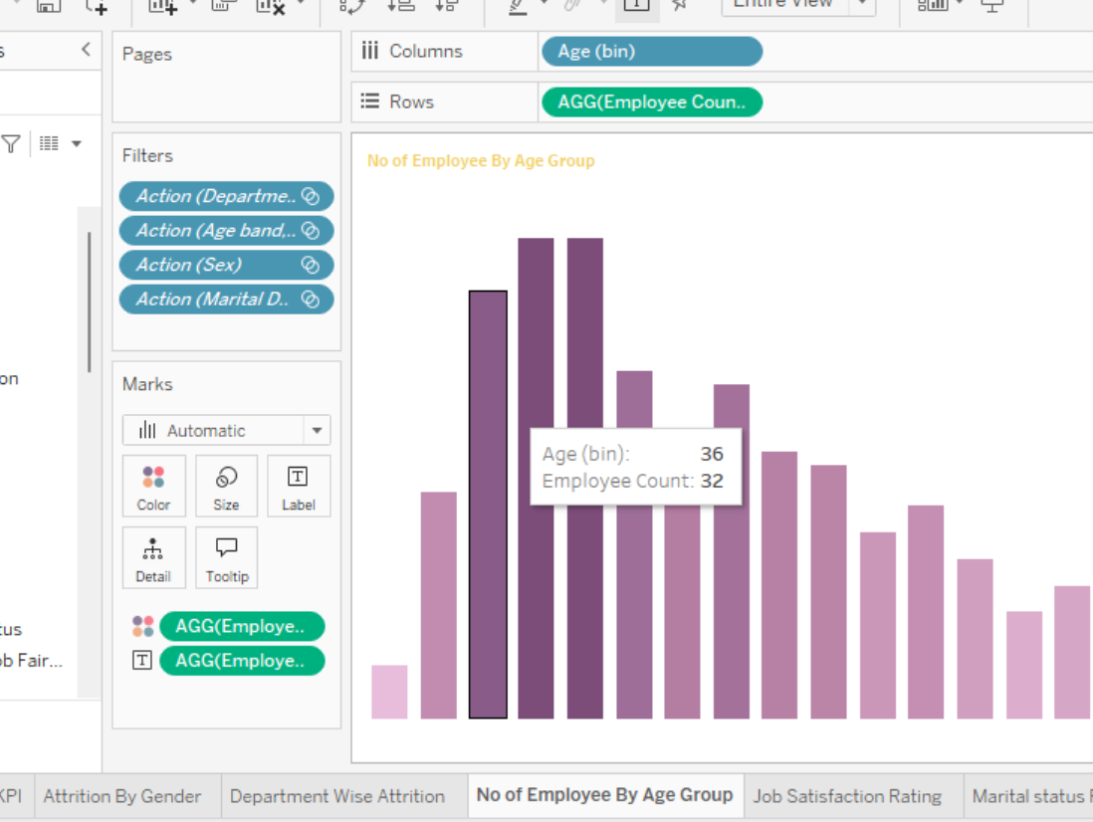
Employees by Age Group

Slide 13
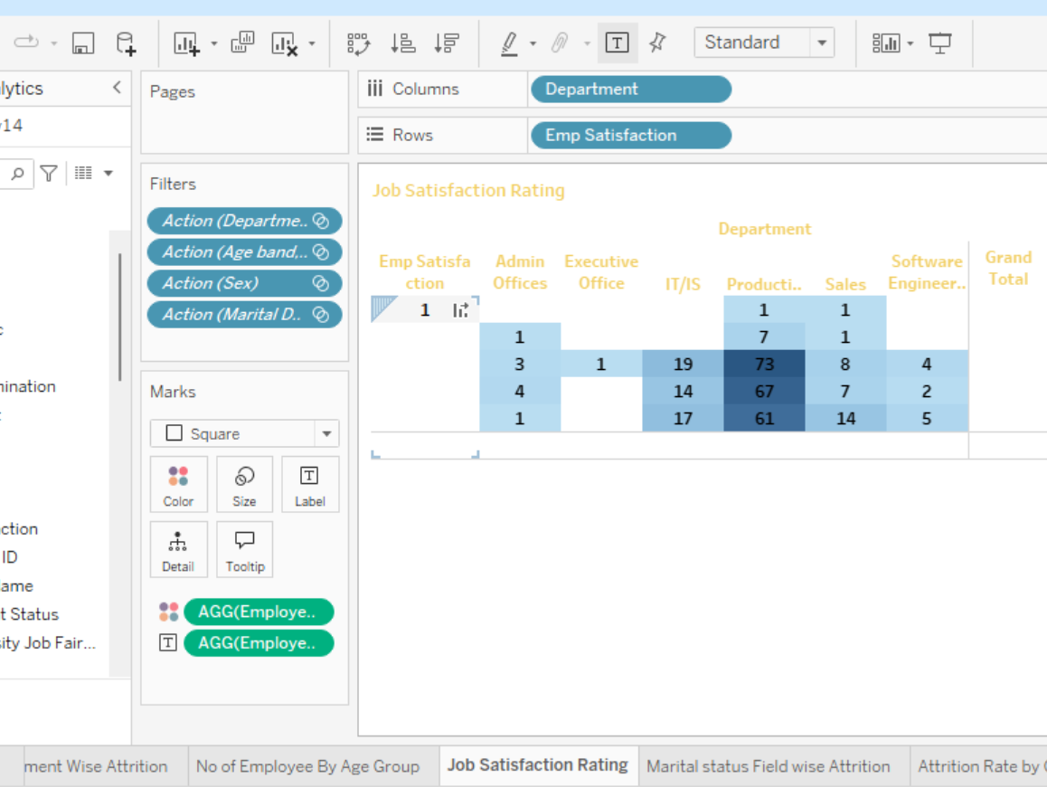
Job Satisfaction Heatmap

Slide 14
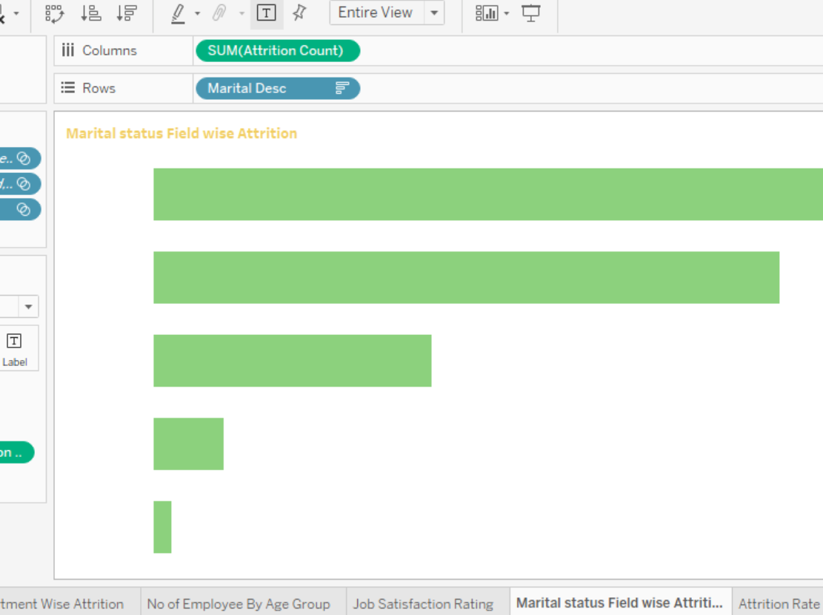
Marital Status & attrition

Slide 15
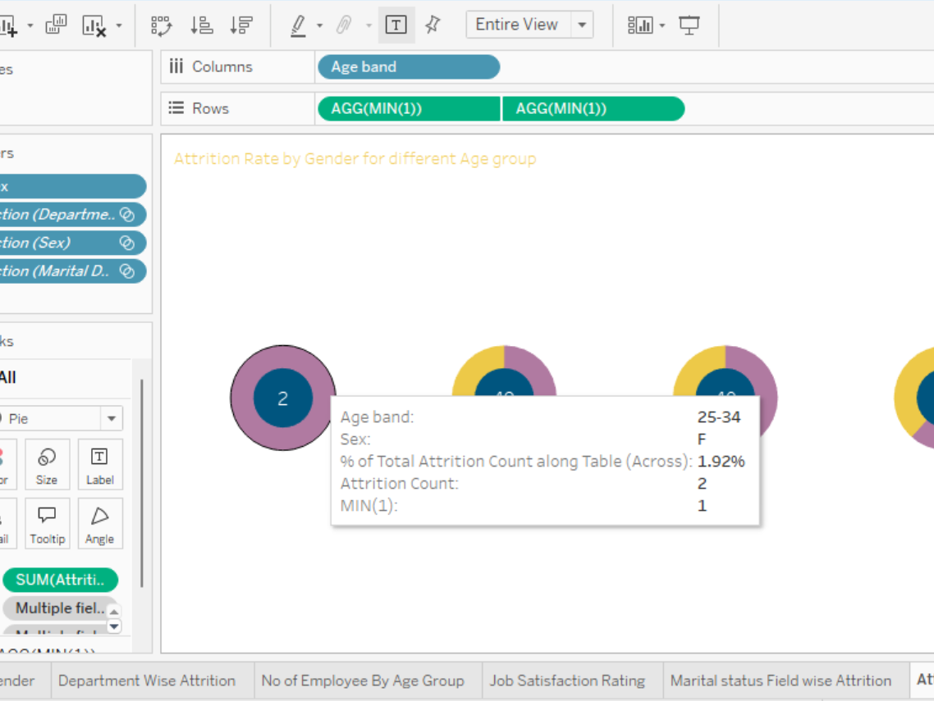
Gender vs Age Group Attrition

Slide 16
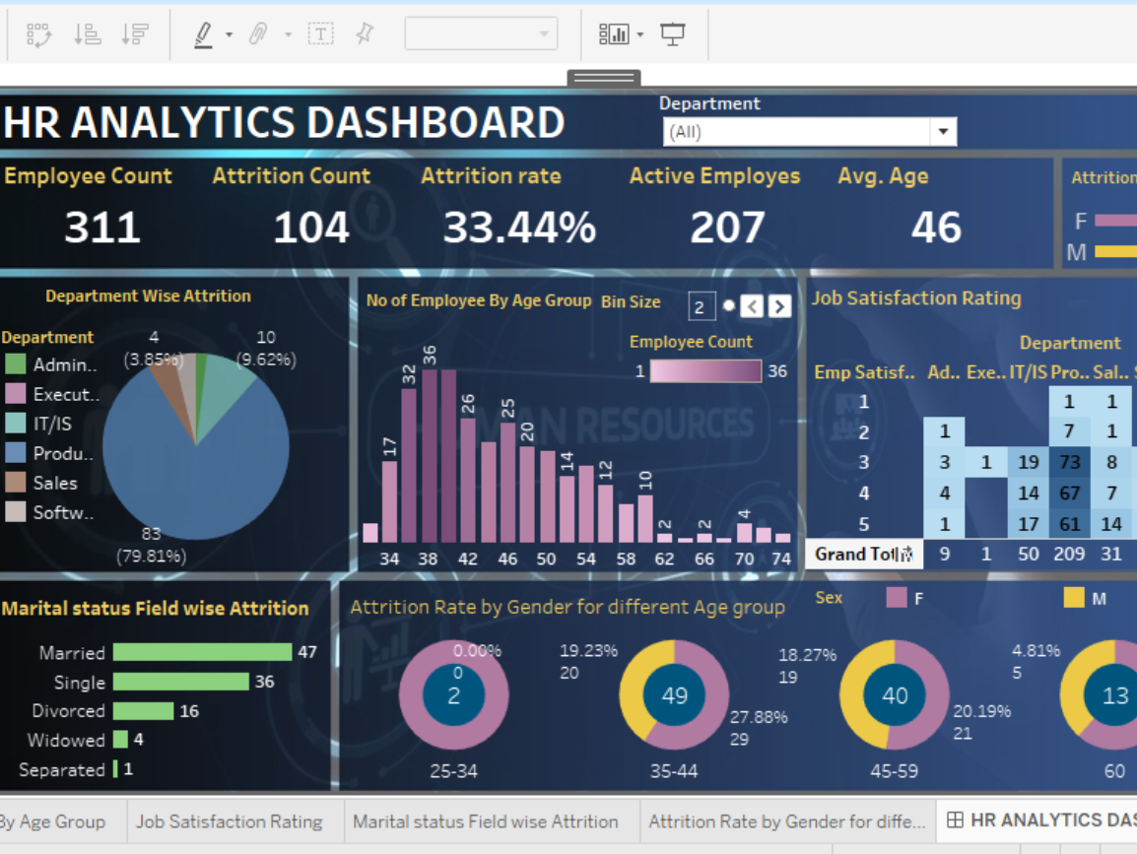
Overall Dashboard View

Slide 17

Q&A
Thank you for your attention.
Let’s discuss any questions or insights.

